Slide 1
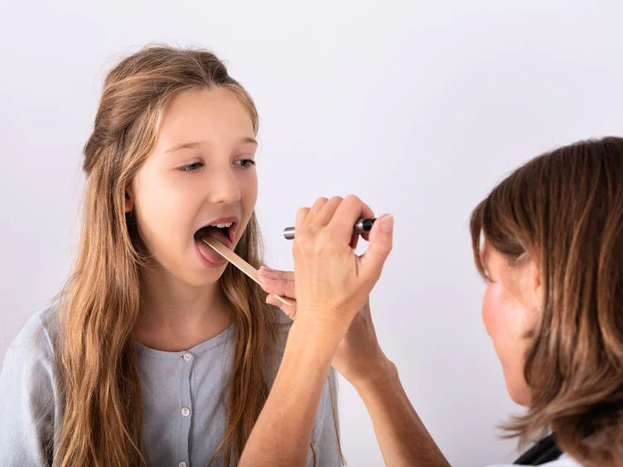
Buccopharyngoscopy

Slide 2
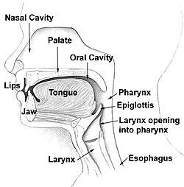
The pharynx is divided into three sections:
nasopharynx
oropharynx
Hypopharynx

Slide 3
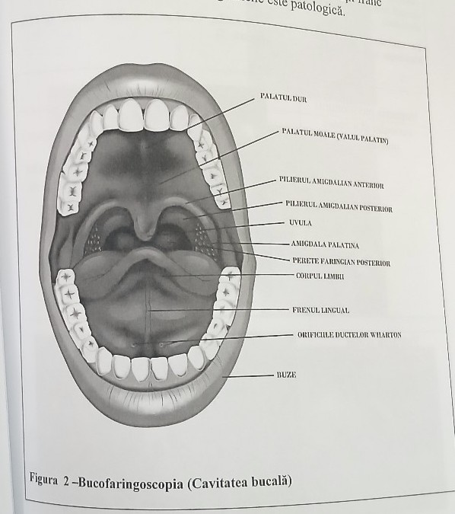
The oral cavity is bounded :
anteriorly, by the inner surface of the lips
posteriorly, by the anterior pillar and the soft palate (oropharyngeal isthmus)
inferiorly, by the floor of the mouth
superiorly, by the hard palate and the palatine bone

Slide 4
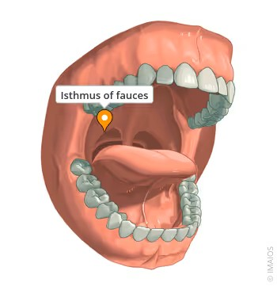
The oropharyngeal isthmus:
the lower edge of the soft palate, the anterior tonsillar pillars, and the base of the tongue, separating the oral cavity from the oropharynx

Slide 5
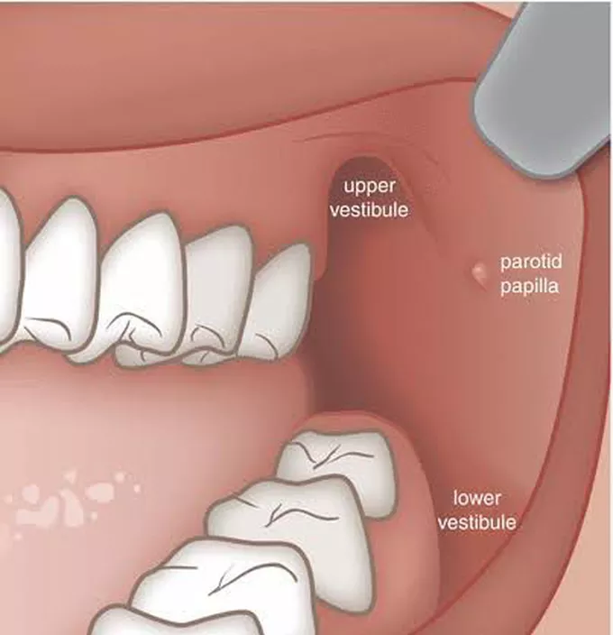
The oral cavity is divided by the upper and lower dental arches into two compartments:
the inner oral vestibule: the buccal mucosa and the teeth
the oral cavity proper, bounded anteriorly and laterally by the inner surface of the dental arches.

Slide 6
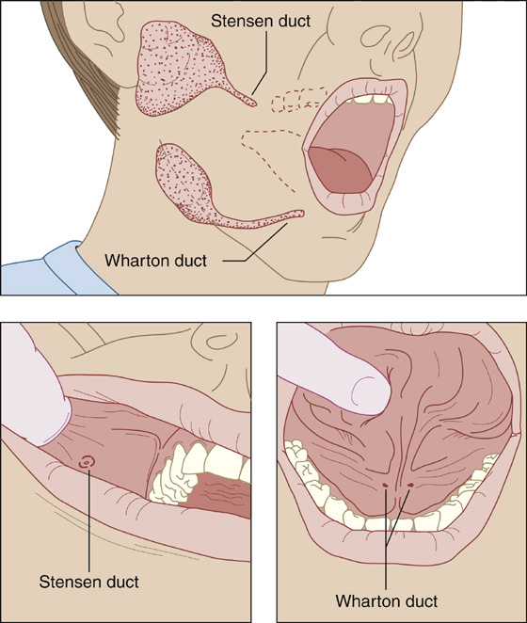
The floor of the tongue”
It is formed by the mylohyoid muscle. At this level we find: the lingual frenulum, the opening of the sublingual gland, and the submandibular gland (Wharton's duct).
Stensen's duct – the drainage duct of the parotid gland – opens into the oral vestibule opposite the second upper molar.

Slide 7
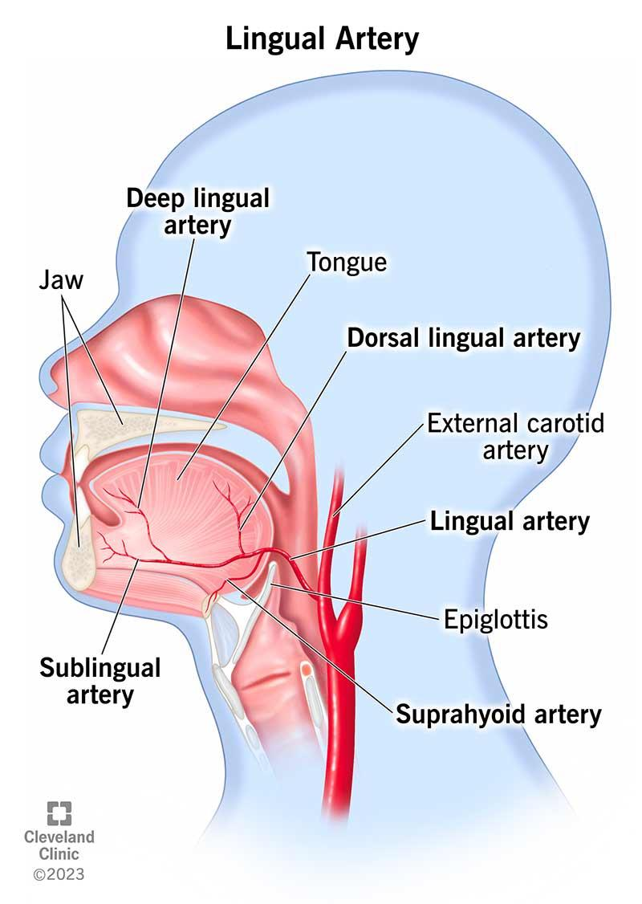
Arterial supply – branches from the external carotid artery at the level of the floor of the mouth: the lingual artery and the sublingual artery.
Veins – venous plexuses drain into the facial vein, pterygoid venous plexuses, internal jugular vein, and cavernous sinus.
Lymphatics – drain into the submental, submandibular, and parotid lymph nodes.

Slide 8
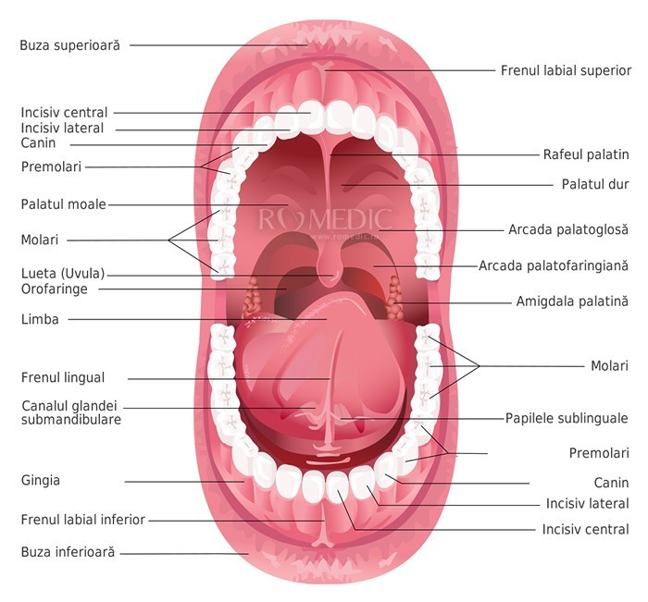
What do we have to examine
Buccal mucosa
Oral vestibule
Teeth
Floor of the mouth
Tongue
Buccal mucosa
Stensens duct
Wharton duct
Palatine tonsils
Uvula
Soft palate
Hard palate
Posterior pharyngeal wall

Slide 9
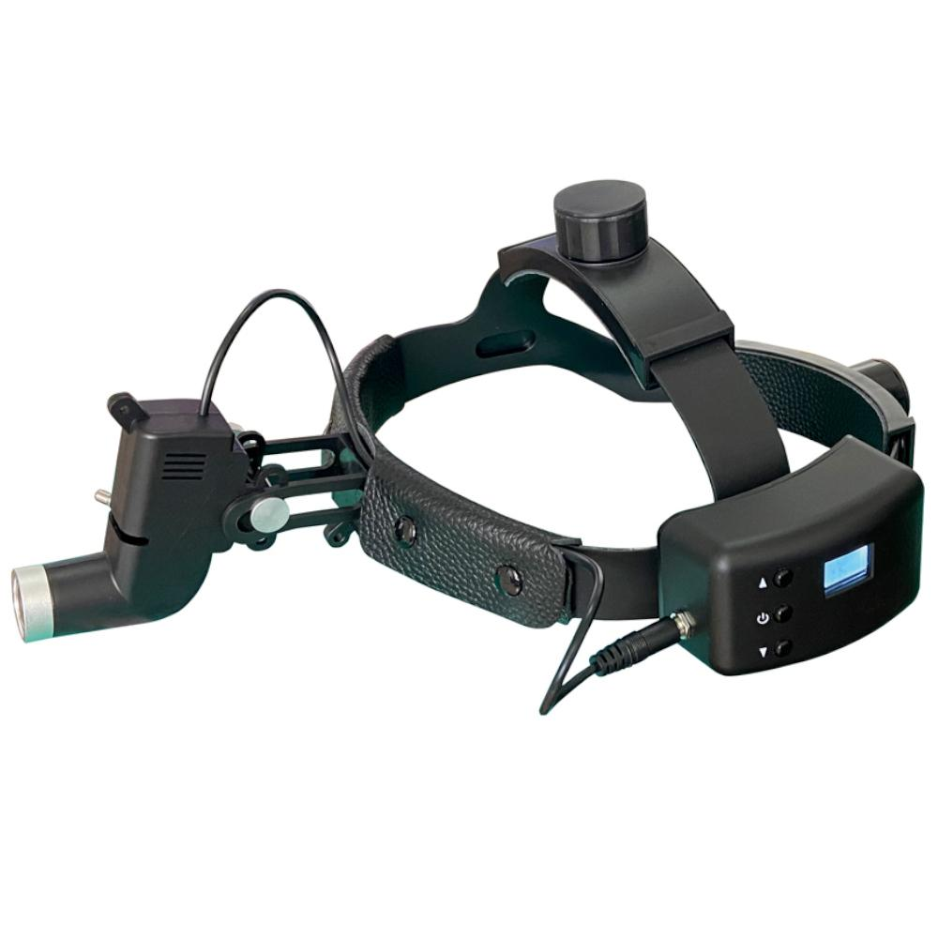
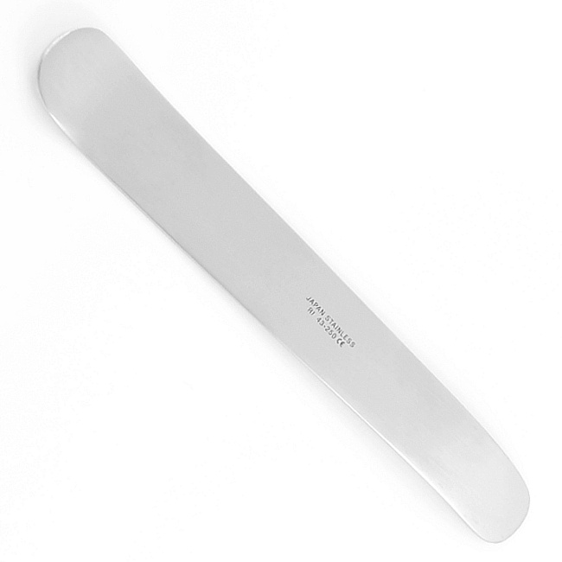
Instrumentar utilizat:

Slide 10
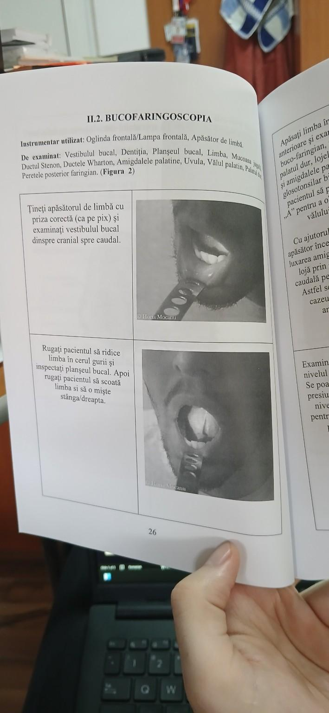
Hold the tongue depressor with the correct grip (like holding a pen) and examine the oral vestibule from cranial to caudal.
Ask the patient to lift their tongue to the roof of the mouth and inspect the floor of the mouth. Then, ask the patient to stick out their tongue and move it left and right

Slide 11
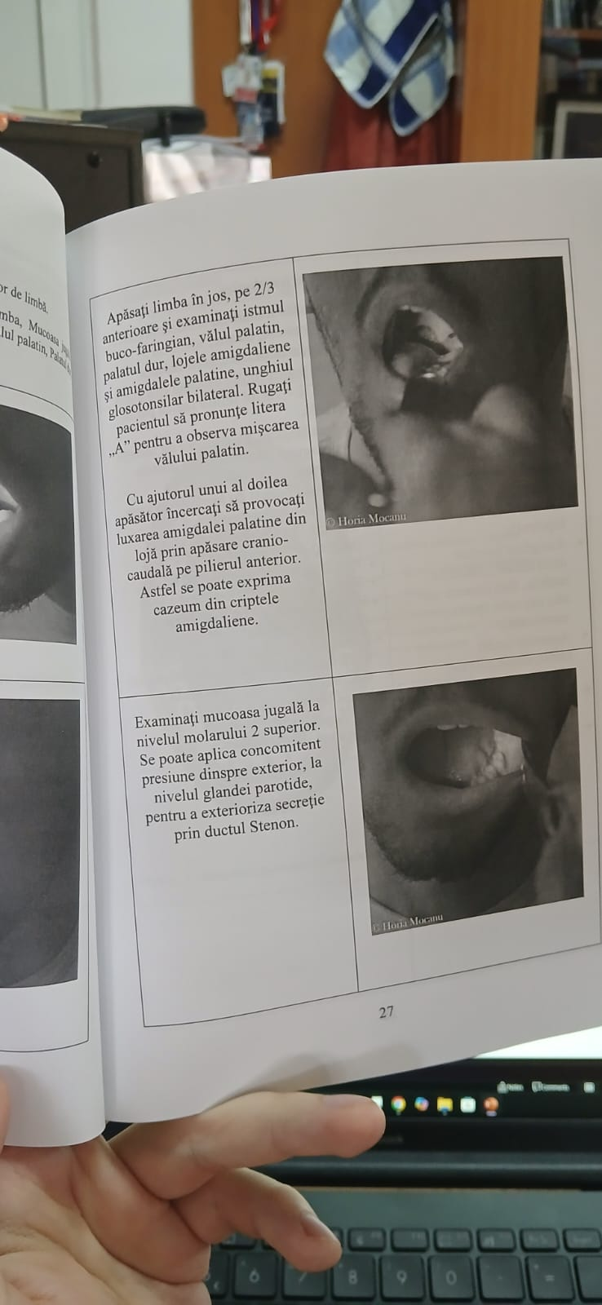
The oropharyngeal isthmus examination
Press the tongue down on its anterior two-thirds and examine:
The oropharyngeal isthmus
The soft palate
The hard palate
The tonsillar fossae and the palatine tonsils
The bilateral glossotonsillar angle
Instruction: Ask the patient to say the letter ‘A’ → allows observation of soft palate movement

Slide 12
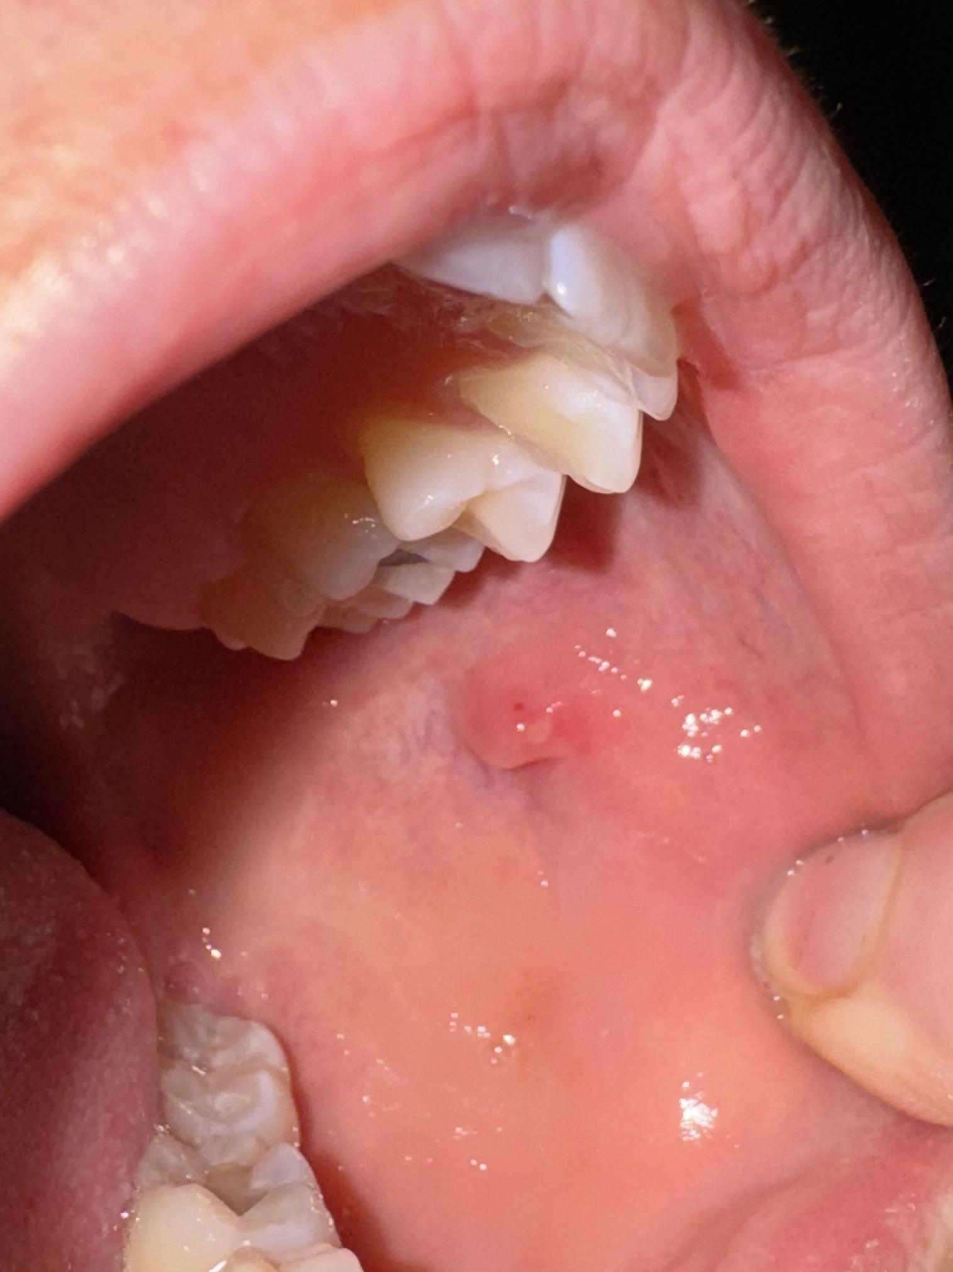
Examination of the buccal mucosa (Stensen’s duct area)
Examine the buccal mucosa at the level of the second upper molar
Method: Apply gentle external pressure over the parotid gland to stimulate secretion through Stensen’s duct

Slide 13
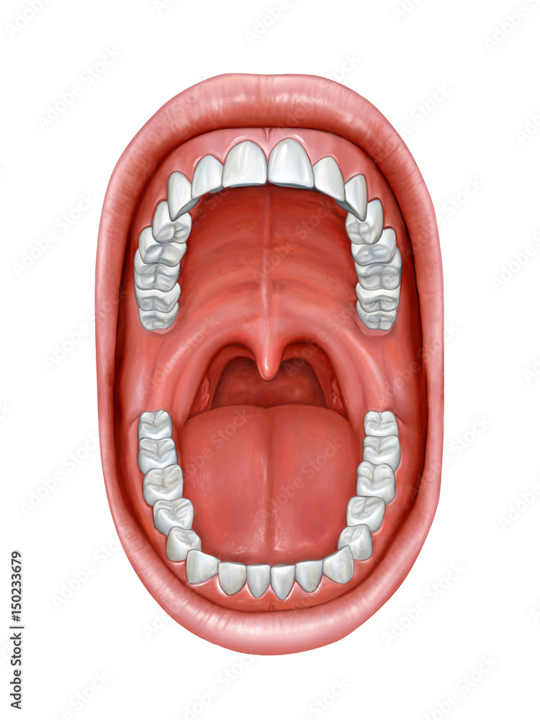
Normal aspects:
Labial and vestibular mucosa: normally pigmented, well hydrated
Dentition: intact, complete
Floor of the mouth and Wharton's ducts: normal appearance, no pathological secretions
Buccopharyngeal mucosa: normal color and hydration, no hypertrophy or atrophy
Palatine tonsils: non-inflamed, symmetrical, mobile, without caseum, pus, or membranes
Tongue appearance: normal size, color, and hydration, no deposits
Tongue mobility: normal
Soft palate mobility: normal (elevates upon pronunciation of the letter “A”)

Slide 14
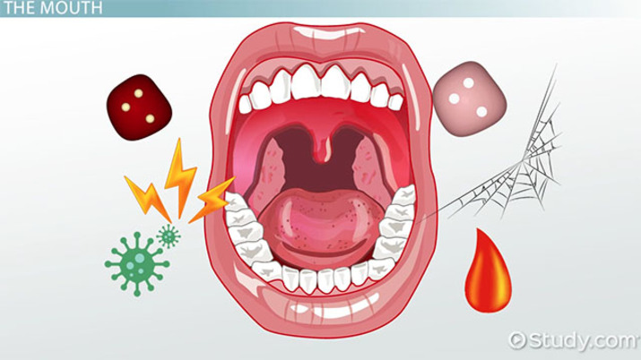
Aspecte patologice:
Labial mucosa: lesions, vesicles, aphthous ulcers, tumors, edema
Dentition: cavities, missing teeth
Impaired tongue mobility → Hypoglossal nerve (CN XII) paralysis (tongue tip deviates toward the affected side)
Lingual edema, purulent discharge from Wharton's ducts
Buccal mucosa: lesions, vesicles, aphthae, tumors
Tumors (tongue, tonsils, soft palate)
Soft palate paralysis → cranial nerves IX, X
Uvular edema
Purulent discharge from Stensen’s duct
Koplik’s sign – in the area of Stensen’s duct opening (near the second upper molar):
edematous buccal mucosa
intensely hyperemic
white spots → pathognomonic sign for measles

Slide 15
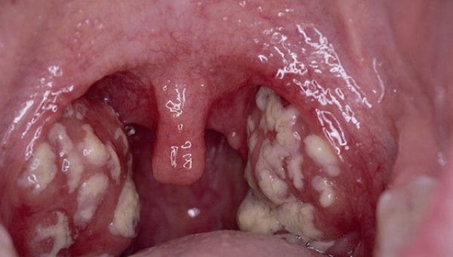
Acute erythematous-pultaceous tonsillitis

Slide 16
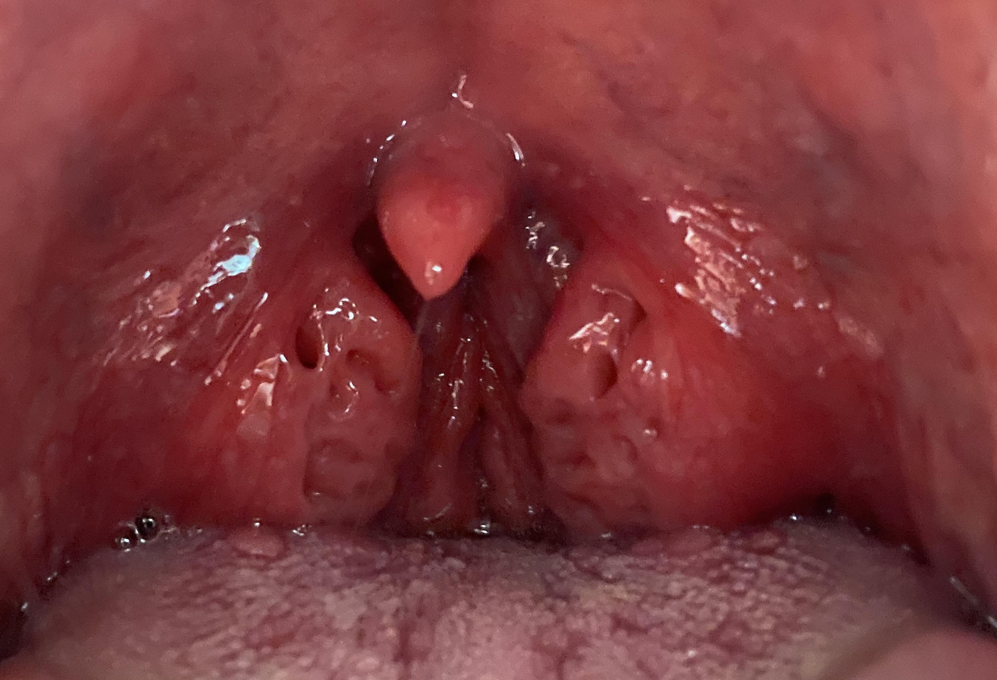
Chronic tonsillitis

Slide 17
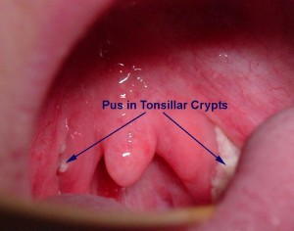
Caseum

Slide 18
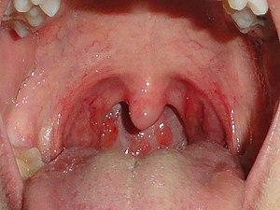
Viral pharyngitis

Slide 19
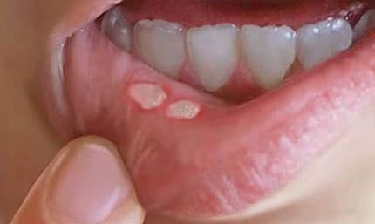
Oral aphthae

Slide 20
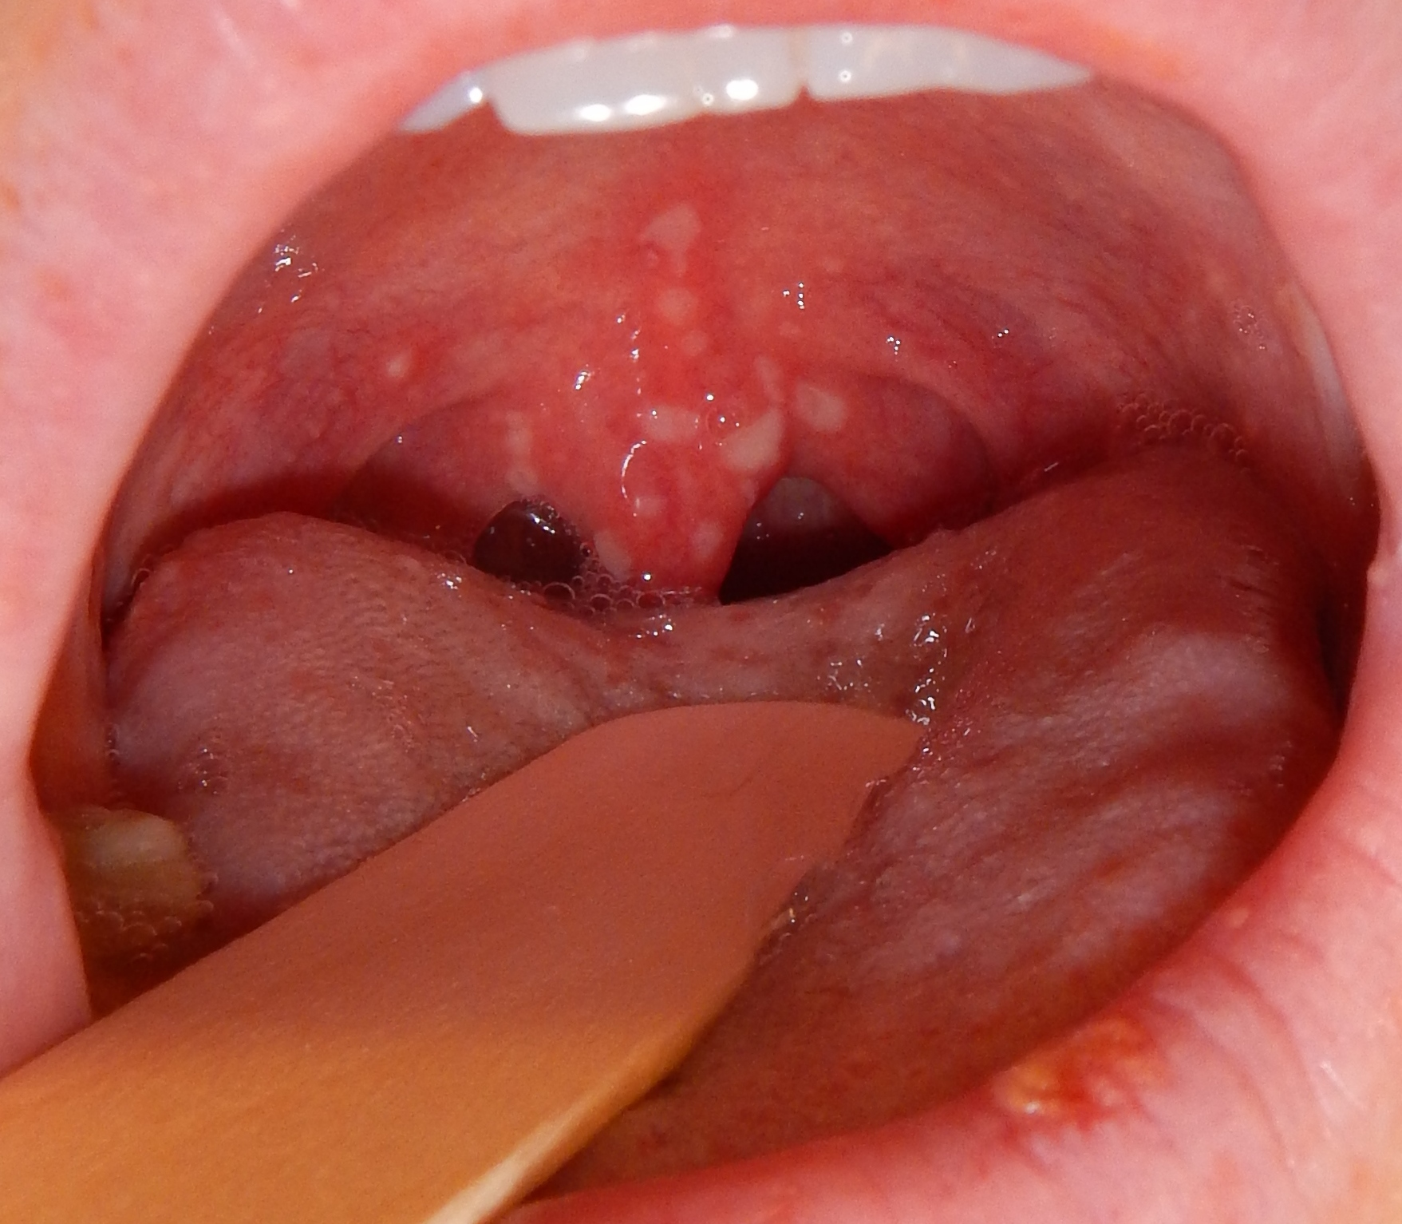
Herpangina

Slide 21
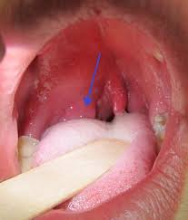
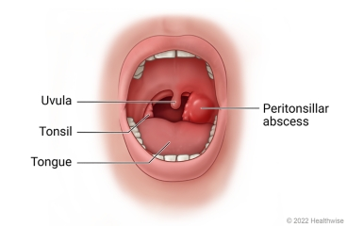
Peritonsillar abscess (phlegmon/phlegmonous infiltration)

Slide 22
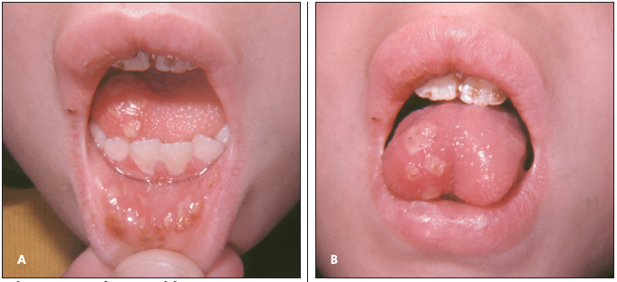
Herpetic lesions (HSV)

Slide 23
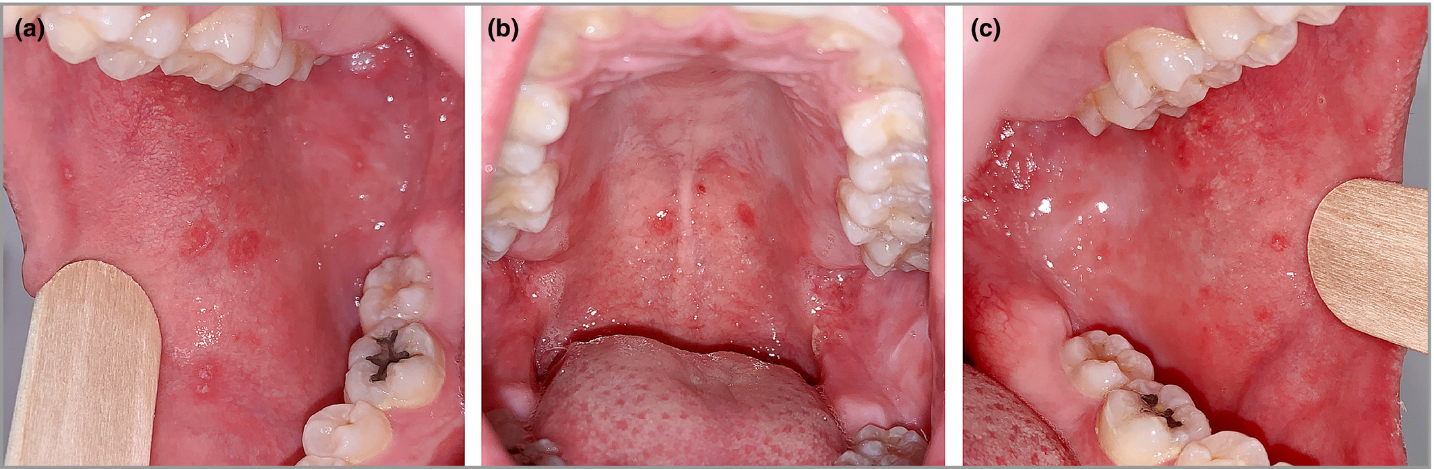
Koplik’s sign (measles)

Slide 24
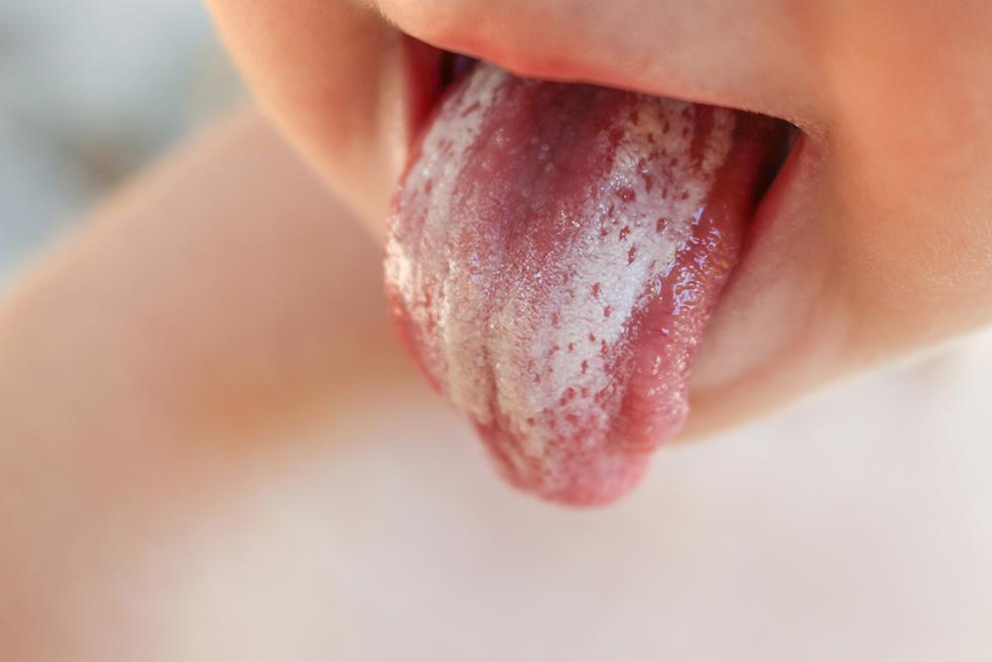
Candidal stomatitis

